Slide 1

Introduction to Major Cloud Providers and Services
Introduction to Cloud Computing
AWS, Azure, Google Cloud & Cloud Marketplaces

Slide 2
Lecture Objectives
Understand the top cloud providers and their market dominance.
Compare services and strengths of AWS, Azure, and Google Cloud.
Explore cloud marketplaces and their role in cloud adoption.
Participate in Lab-2: Exploring cloud provider service offerings.

Slide 3
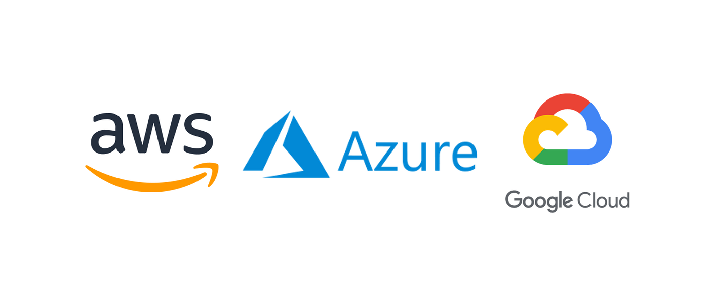
Overview of Leading Cloud Providers
Amazon Web Services (AWS):
Market leader in cloud computing.
Wide range of services including compute, storage, AI, and databases.
Microsoft Azure:
Strong enterprise adoption and integration with Microsoft products.
Hybrid cloud and AI-driven solutions.
Google Cloud Platform (GCP):
Strong in AI/ML, analytics, and Kubernetes.
Competitive pricing and open-source focus..

Slide 4
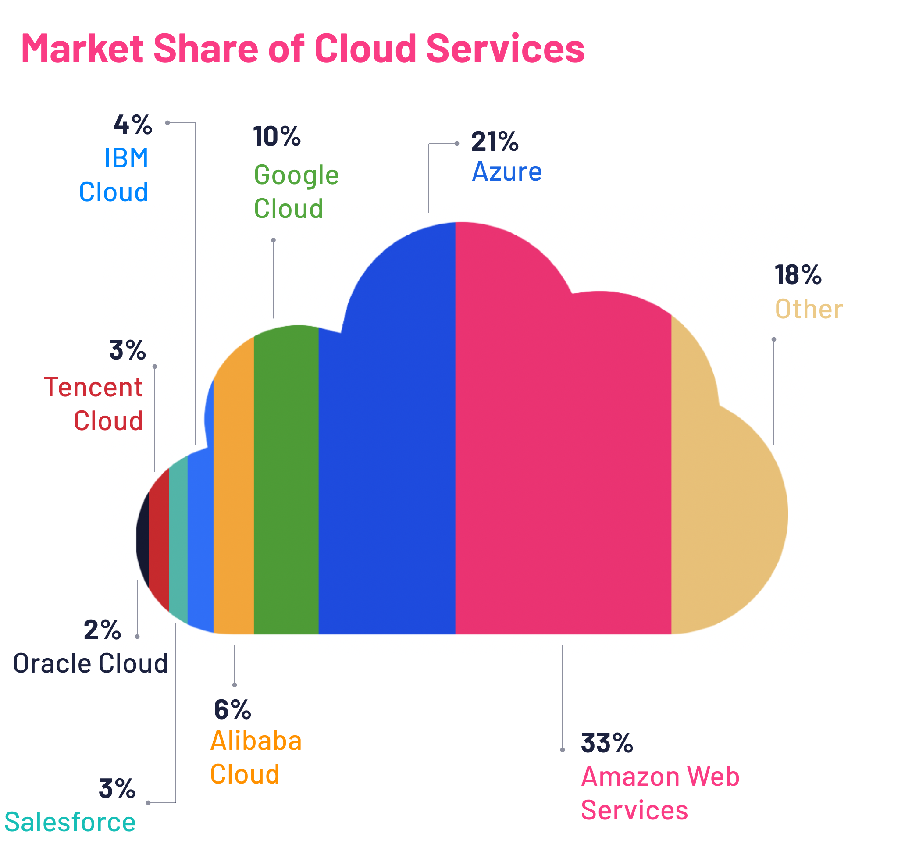
Cloud Market Share and Trends
Cloud Market Share (2023 Data):
AWS: ~33%
Azure: ~21%
GCP: ~10%
Others: ~36% (IBM, Oracle, Alibaba, etc.)
Trends:
Increased multi-cloud adoption.
AI and Machine Learning services driving cloud growth.
Edge computing and serverless adoption.

Slide 5
Comparing Cloud Provider Services
Category | AWS | Azure | GCP
Compute | EC2, Lambda | Virtual Machines, Functions | Compute Engine, Cloud Run
Storage | S3, EBS, Glacier | Blob, Disk Storage | Cloud Storage, Filestore
Database | RDS, DynamoDB, Aurora | SQL Database, Cosmos DB | Cloud SQL, BigQuery
AI/ML | SageMaker, Rekognition | Azure AI, Cognitive Services | Vertex AI, AutoML
Networking | VPC, Route 53, ELB | Virtual Network, Load Balancer | VPC, Cloud CDN, Cloud DNS

Slide 6

AWS Strengths
Largest cloud provider with extensive service offerings.
Global network with the most regions and availability zones.
Rich ecosystem for startups, enterprises, and government.
Best for: Scalability, large-scale computing, diverse workloads.

Slide 7

Azure Strengths
Strong integration with Microsoft tools (Windows Server, Office 365, SQL Server).
Hybrid and on-premises support with Azure Arc.
Best for: Enterprises using Microsoft products, hybrid cloud, compliance-driven organizations.

Slide 8
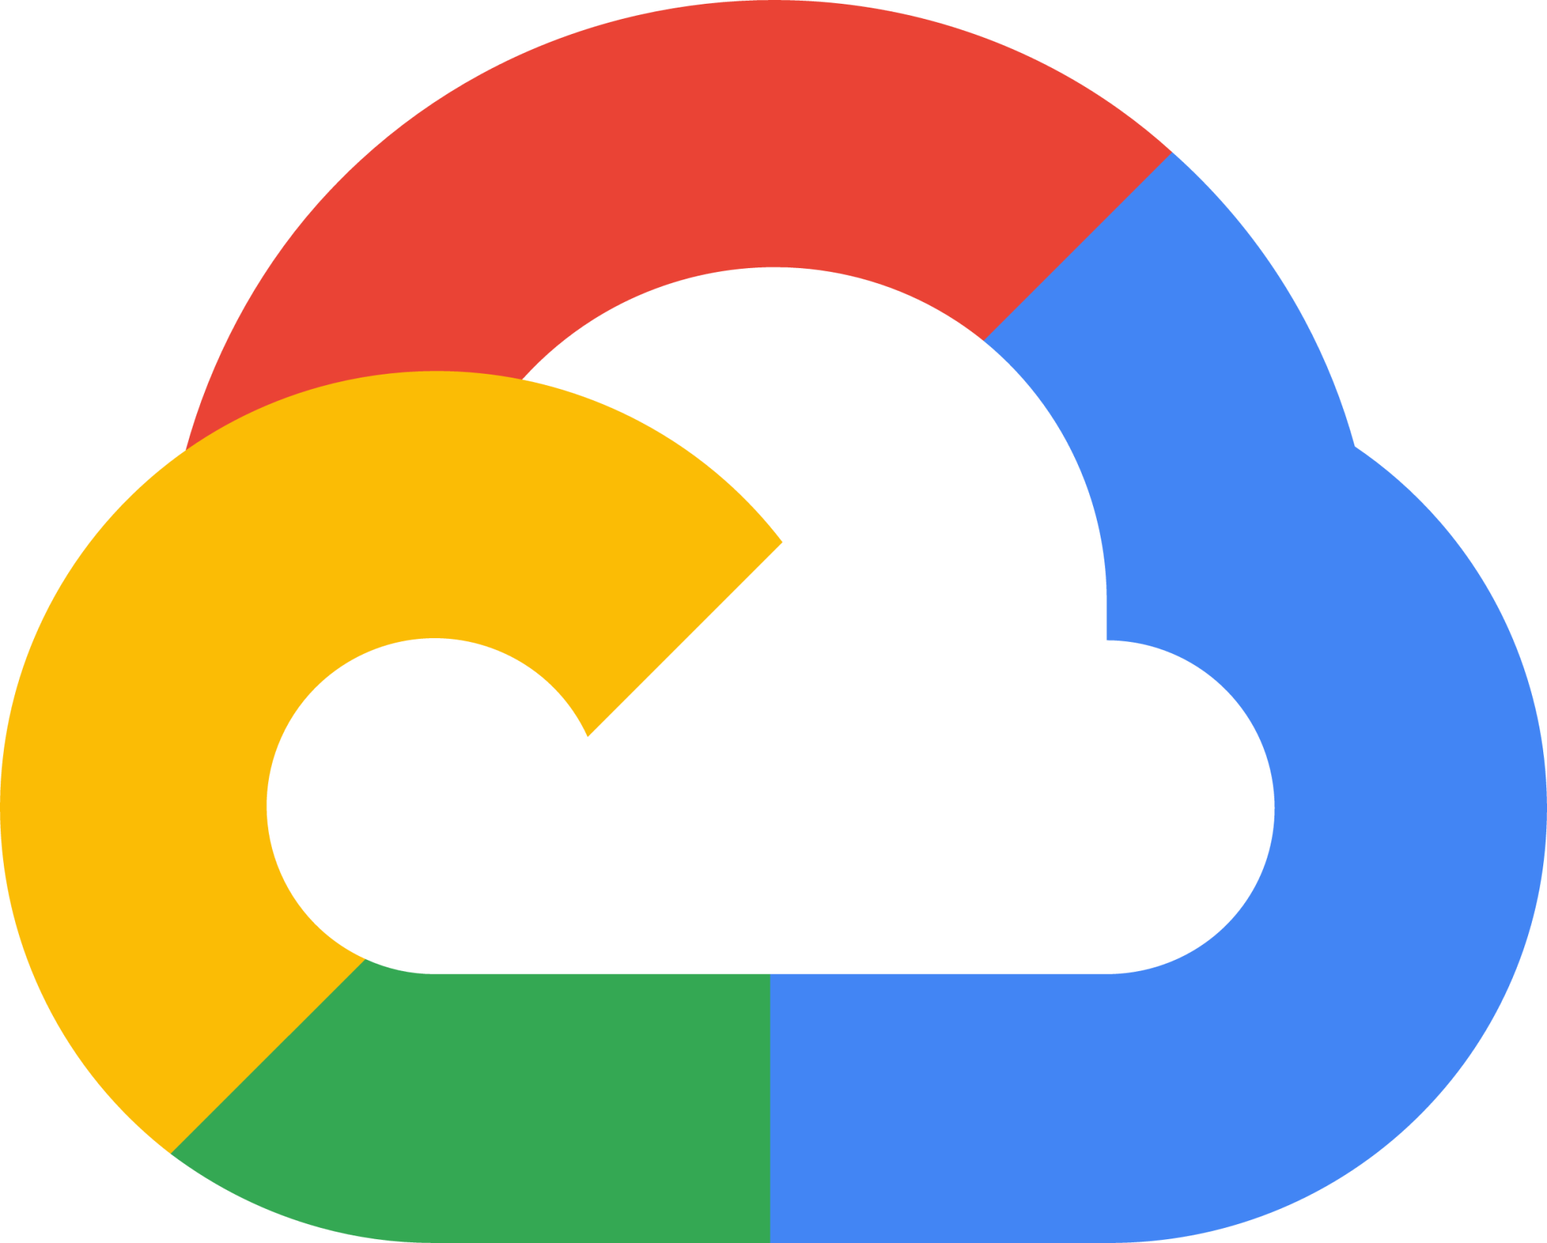
Google Cloud Strengths
Leader in AI and Machine Learning (TensorFlow, Vertex AI).
Containerization and Kubernetes leadership (GKE).
Best for: Data analytics, AI-driven applications, open-source workloads.

Slide 9

Introduction to Cloud Marketplaces
Definition: Online portals where customers can discover, buy, and deploy cloud-based applications.
Examples:
AWS Marketplace
Azure Marketplace
Google Cloud Marketplace

Slide 10
Benefits of Cloud Marketplaces
Faster deployment of third-party solutions.
Pre-configured integrations with cloud provider services.
Subscription-based models for scalability.

Slide 11
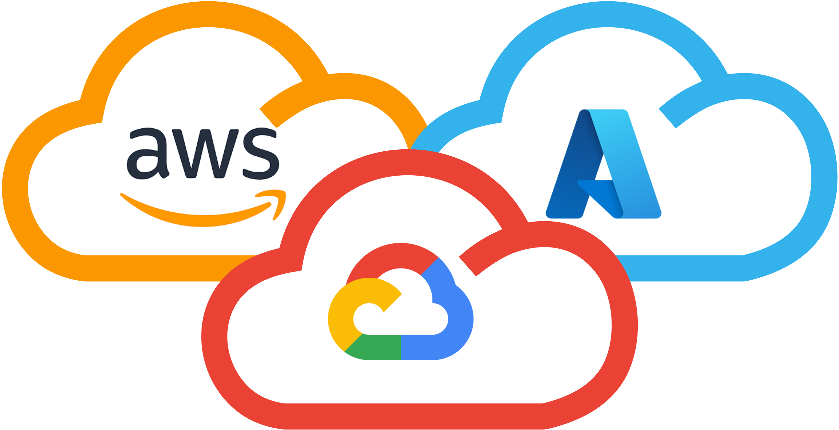
Multi-Cloud Considerations
Why Multi-Cloud?
Avoid vendor lock-in.
Best-of-breed services from different providers.

Slide 12
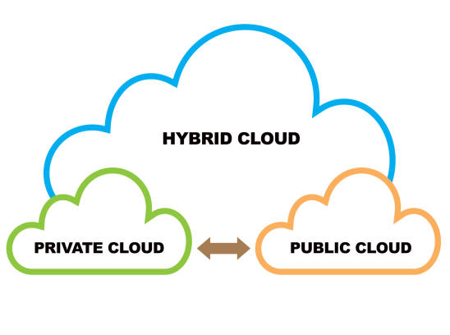
Hybrid Cloud Considerations
Why Hybrid Cloud?
Balance between private data security and public scalability.
Compliance with regulatory requirements.

Slide 13
Lab-2: Exploring Cloud Provider Services
Activity:
Hands-on exploration of AWS, Azure, or GCP services.
Tasks:
Create a free-tier account.
Deploy a simple virtual machine or storage bucket.
Explore AI/ML and networking services.
Assessment: Lab-1 (1.5%)

Slide 14
Summary
AWS: Most comprehensive cloud offering, best for scalability.
Azure: Enterprise-focused, best for Microsoft integrations.
GCP: Best for AI/ML, open-source, and analytics workloads.
Cloud Marketplaces make it easier to adopt third-party solutions.

Slide 15
Questions?

